Slide 1

CipherChain: The Architecture of Immutable Logging
Implementing Cryptographic Integrity via Merkle Trees and SHA-256 Chaining. A mini-blockchain case study designed for modern security engineering and high-fidelity audit trails.

Slide 2


The Core Problem: Log Vulnerability
The "Flat File" Risk
In traditional systems, logs are stored as simple text files. For an attacker, these are the first target: once they gain root access, they can delete their tracks, making forensic reconstruction impossible.
When the logs are compromised, the "truth" is lost forever.
The CipherChain Solution
By transforming logs into a Cryptographic Chain, we ensure that any unauthorized edit—no matter how small—irreversibly breaks the mathematical structure of the entire ledger.

Slide 3


Project Architecture Overview
Our system is built on a modular Python-based framework, separating the ledger logic from the auditing and control layers to ensure clean, maintainable security code.
blockchain.py
The Ledger: Manages the creation of blocks and the sequential linking of hashes.
merkle.py
The Auditor: Efficiently verifies data integrity using hierarchical hashing trees.
main.py
The Controller: Orchestrates the ingestion of data and triggers validation checks.

Slide 4
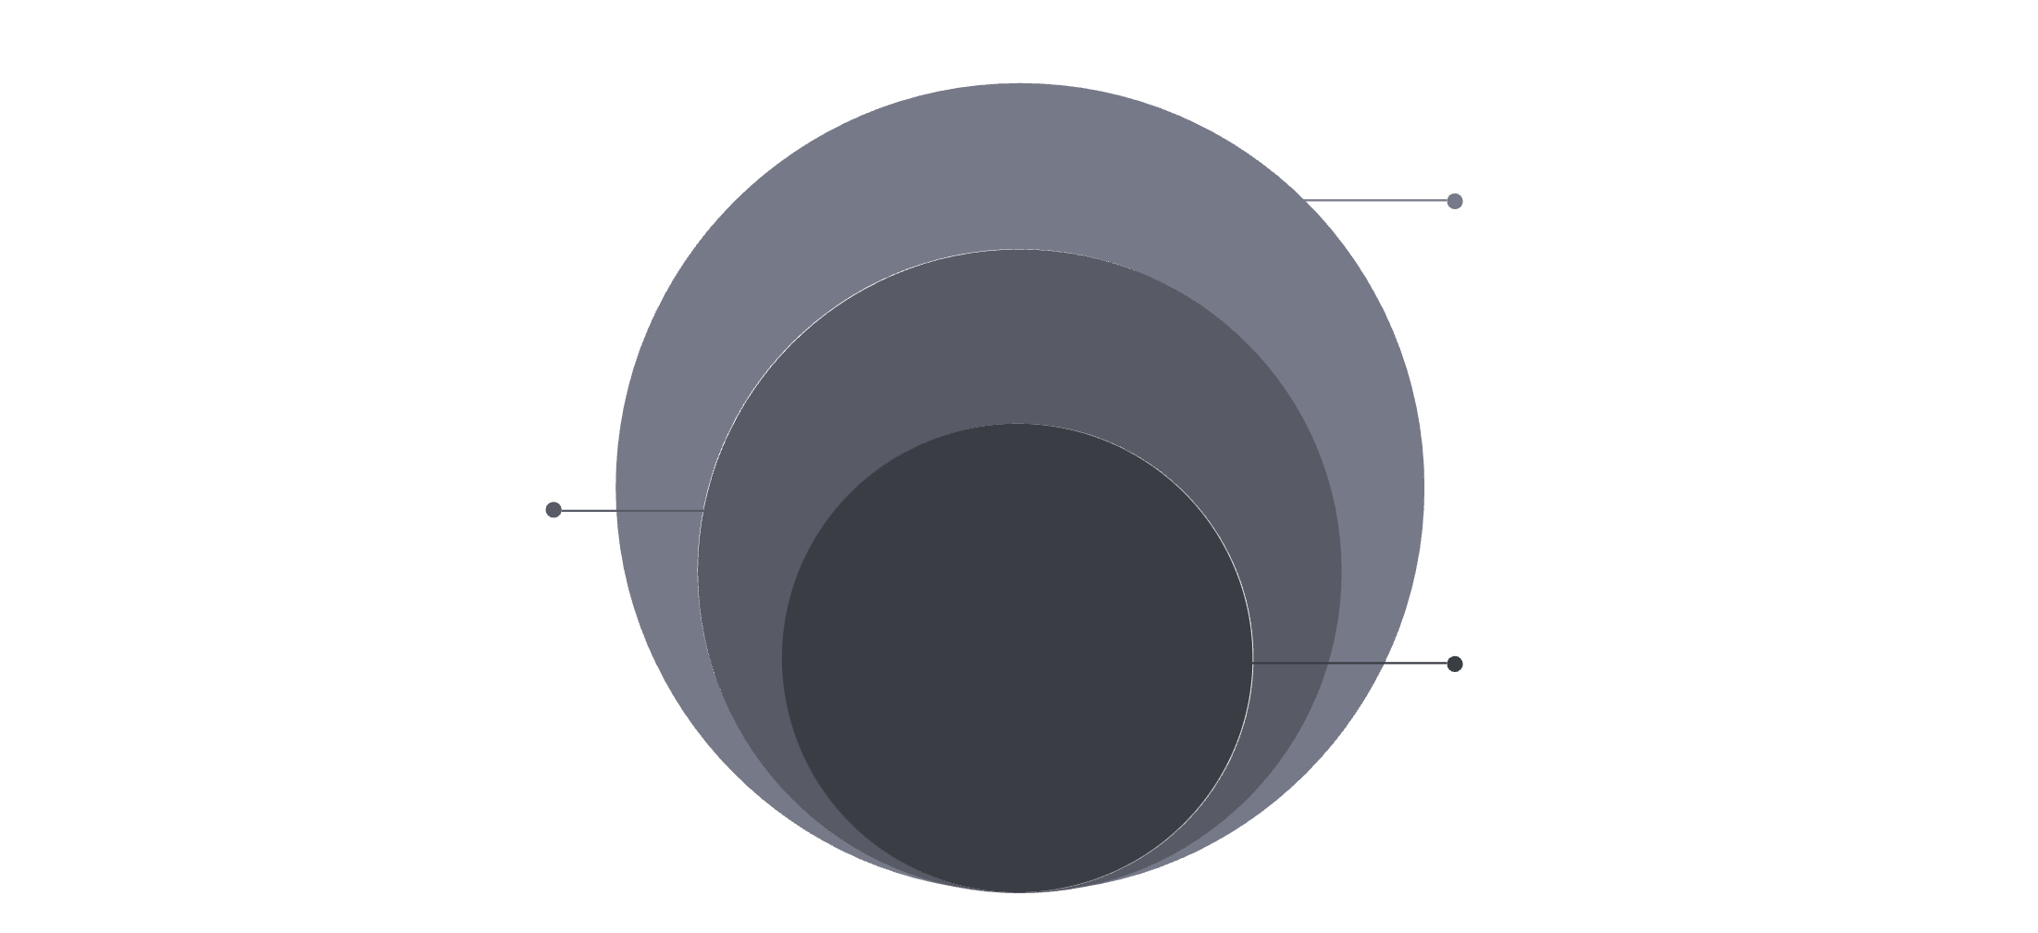
The Power of Merkle Trees
Efficiency via Recursive Hashing
Rather than hashing a massive 1GB log file every time a single entry is added, we use a Merkle Tree to provide a "summary" of the data.
Leaf Nodes
Individual data block hashes for verification
Parent Hashes
Hashes combining child hashes upward
Root Hash
Single summary hash representing entire dataset
Resource Optimization
Constant Root Update
Merkle Trees allow us to verify specific entries without downloading the entire chain.
Only the path to the modified leaf needs recalculation, significantly reducing CPU overhead.

Slide 5

Immutable Chaining via SHA-256
Each block in CipherChain is cryptographically bound to its predecessor. Block N contains the SHA-256 hash of Block N-1, creating a dependency that reaches back to the Genesis Block.
The Hash Link
The "Previous Hash" field acts as a digital seal that cannot be forged.
The Avalanche Effect
Changing just one bit in an early block causes a total divergence in all subsequent hashes.

Slide 6
Methodology: The Lifecycle of a Log
Our process ensures that every event is captured, hashed, and sealed within milliseconds of its occurrence.
01
02
03
Data Ingestion
Merkle Root Generation
Header Construction
Raw log events are structured into JSON format for consistent processing.
Data is hashed into a tree to produce a single identifying Root Hash.
The Root Hash and the Previous Block's hash are combined into a new header.
04
05
Ledger Append
Integrity Check
The completed block is committed to the immutable storage layer.
The system runs a validation pass to ensure the chain remains contiguous.

Slide 7
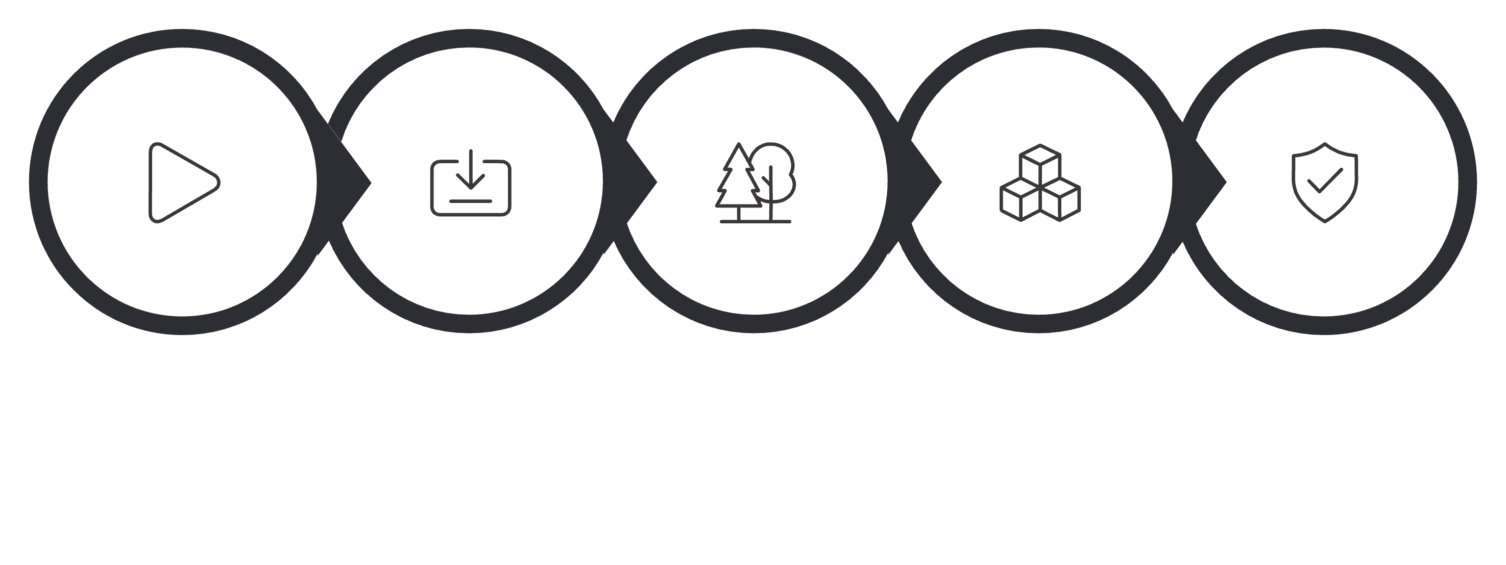
Operational Flowchart
Visualizing the internal logic from data entry to the final validity confirmation.
Start
Log Input
Merkle Tree
Block Create
Chain Validate
By decoupling the ingestion from the validation, we allow for asynchronous auditing, ensuring that the system performance isn't bottlenecked by cryptographic checks during high-traffic periods.

Slide 8

Tamper Detection Simulation
The Attack Scenario
The Defense Response
An intruder manually modifies a log entry in Block #42 to hide a "User Deleted" event. They attempt to save the file back to disk.
The is_chain_valid() function triggers. It detects that the recalculated hash for Block #42 no longer matches the "Previous Hash" stored in Block #43.
Validation Result: [FAILED] Error: Hash mismatch at Block 42. Integrity: Compromised.

Slide 9



Scalability & Scoping
Understanding the boundaries of the CipherChain implementation is key for security architects.
Integrity vs. Consensus
This is a centralized mini-blockchain focused on Data Integrity, not decentralized consensus like Bitcoin's Proof of Work.
High Throughput
Thanks to the Merkle Tree implementation, CipherChain can handle thousands of log events per second with minimal CPU overhead.

Slide 10


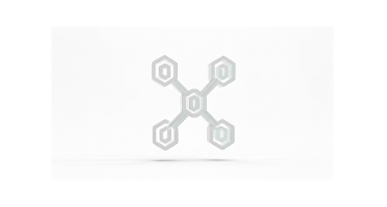
Conclusion & Future Roadmap
"Cryptography replaces trust with mathematical proof."
CipherChain demonstrates that we don't need to trust the system administrator or the infrastructure—we only need to trust the math.
Next Steps on the Horizon
P2P Network Layer
Digital Signatures
Decentralizing the ledger across multiple audit nodes.
Implementing RSA/ECDSA for non-repudiation of log sources.

